Slide 1
Topics
Inheritance
Abstract classes
Interfaces
Polymorphism

Slide 2
Inheritance
Inheritance allows a software developer to derive a new class from an existing one.
Re-usability is at the heart of inheritance.
The existing class is called parent class or superclass or base class
The derived class is called child class or subclass.
That is, the child class inherits the methods and data defined for the parent class
By using existing software components to create new ones, we capitalize on all the effort that went into the design, implementation, and testing of the existing software

Slide 3
Inheritance
Inheritance relationships often are shown graphically in a UML class diagram, with an arrow with an open arrowhead pointing to the parent class
Vehicle
Car
Inheritance should create an is-a relationship, meaning the child is a more specific version of the parent

Slide 4
Inheritance
In Java, we use the reserved word extends to establish an inheritance relationship.
public class Car extends Vehicle {
//class contents...
}

Slide 5
Inheritance
Visibility modifiers determine which class members are inherited and which are not
Variables and methods declared with visibility are inherited; those with visibility are not
But variables violate the principle of encapsulation
There is a third visibility modifier that helps in inheritance situations: protected

Slide 6
Inheritance
The protected modifier allows a member of a base class to be inherited into a child.
Protected visibility provides more encapsulation than public visibility does.
However, protected visibility is not as tightly encapsulated as private visibility
Protected variables and methods can be shown with a # symbol preceding them in UML diagrams

Slide 7

UML - Class Diagram
VehicleInfo
- registrationNo : String
- model : String
- make : String
- engineNo : String
- year : int
+ getRegistrationNo() : String
+ setRegistrationNo(regno : String) : String
+ getModel() : String
+ setModel(model : String) :String

Slide 8
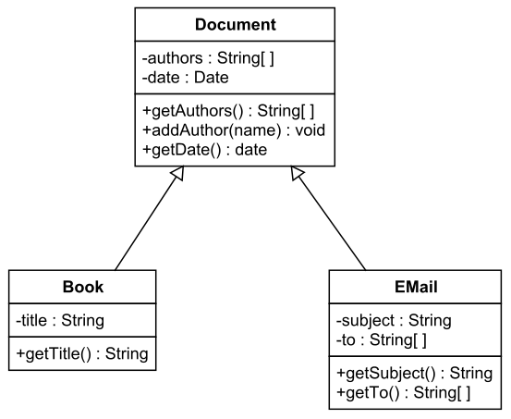
UML – Inheritance

Slide 9
'super '
Constructors are not inherited, even though they have public visibility
Yet we often want to use the parent's constructor to set up the "parent's part" of the object
The 'super' reference can be used to refer to the parent class, and often is used to invoke the parent's constructor

Slide 10
'super'
A child’s constructor is responsible for calling the parent’s constructor.
The first line of a child’s constructor should use the 'super' reference to call the parent’s constructor.
The 'super' reference can also be used to reference other variables and methods defined in the parent’s class.

Slide 11
Multiple Inheritance
Java supports only Single Inheritance, meaning a derived class can have only one parent class.
Java does not support multiple inheritance.
In most cases, the use of interfaces gives us aspects of multiple inheritance without the overhead

Slide 12
Overriding methods
A child class can override the definition of an inherited method in favor of its own
The new method must have the same signature as the parent's method, but can have a different body
The type of the object executing the method determines which version of the method is invoked

Slide 13
Overriding methods
A parent method can be invoked explicitly using the super reference
If a method is declared with the final modifier, it cannot be overridden
The concept of overriding can be applied to data and is called shadowing variables
Shadowing variables should be avoided because it tends to cause unnecessarily confusing code

Slide 14
Overloading vs Overriding
Overloading deals with multiple methods with the same name in the same class, but with different signatures
Overriding deals with two methods, one in a parent class and one in a child class, that have the same signature
Overloading lets you define a similar operation with different data
Overriding lets you define a similar operation in different ways for different object types

Slide 15
Object class
A class called Object is defined in the java.lang package of the Java standard class library
All classes are derived from the Object class
If a class is not explicitly defined to be the child of an existing class, it is assumed to be the child of the Object class
Therefore, the Object class is the ultimate root of all class hierarchies

Slide 16
Object class
The Object class contains a few useful methods, which are inherited by all classes.
  toString()
    equals(Object o)
    hashCode()
    clone()
    wait()
    notify()
    notifyAll()

Slide 17
Abstract class
Abstraction is a process of hiding the implementation details and showing only the functionality to the user.
Abstraction lets us focus on what the object does instead of how it does it.
We use the modifier abstract on the class header to declare a class as abstract
public abstract class Whatever{
// contents
}
Abstract classes cannot be instatiated.

Slide 18
Abstract class
An abstract class often contains abstract methods (Method with no body)
Unlike an interface, the abstract modifier must be applied to each abstract method
An abstract class typically contains non-abstract methods (with bodies), further distinguishing abstract classes from interfaces
A class declared as abstract does not need to contain abstract methods

Slide 19
Abstract class
The child of an abstract class must override the abstract methods of the parent, or it too will be considered abstract
An abstract method cannot be defined as final (because it must be overridden) or static (because it has no definition yet)
The use of abstract classes is a design decision – it helps us establish common elements in a class that is too general to instantiate

Slide 20
Example..
abstract class Bank{
abstract int getRateOfInterest();
}
class ICICI extends Bank{
int getRateOfInterest(){return 7;}
}
class AXIS extends Bank{
int getRateOfInterest() {return 7;}
}
class TestBank{
public static void main(String[] args){
Bank b = new ICICI();
int interest = b.getRateOfIntrest();
System.out.println("Rate of Interest is: "+interest+" %");
}
}

Slide 21
Interfaces
Interfaces provides 100% abstraction.
Interfaces can have constants and abstract methods.
All variables are public static final in interface
All methods are public abstract in interface
Syntax:
public interface MyInterface {
public static final int MAX=90;
public abstract void abstractmethod();
}

Slide 22
Example...
public interface Printable{
String print();
}
public interface Showable{
String show();
}
public class A4 implements Printable,Showable{
public String print(){return hello}
public String show(){return Welcome}
public static void main(String args[]){
A4 obj = new A4();
System.out.println( obj.print());
System.out.println( obj.show());
}
}

